Slide 1
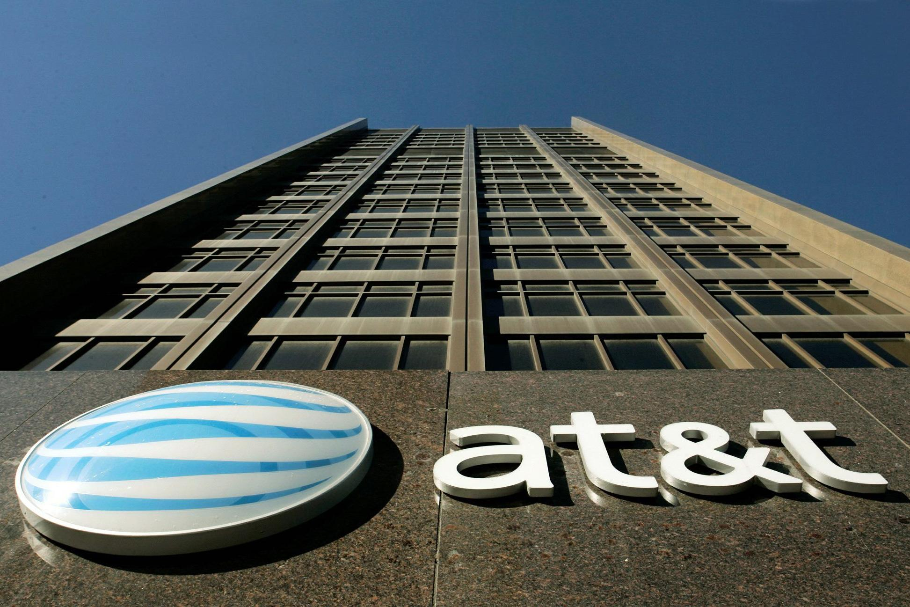
Starz as a Potential Target

Slide 2


Executive Summary
Increase shareholder value? Yes
→ Strategic – Content is essential for adaptability to changing trends
→ Financial – 1.2 to 2.4% accretion over 5 years
Reasonable offer? $4.9B ($36.63/share)
→ 30% premium
→ $500m cash, 0% stock, debt financing
Concerns? Ownership
→ High Lionsgate Stake - Malone
Notes:
creation that has plans for international expansion
Malone wants starz to be sold based off of
Competition for acquisitions in content segment
Adds stickiness to DirecTV which is essential in AT&T’s strategic connectivity plan
International Expansion ease with having content
Malone just wants deal to go through for

Slide 3
Strategy & Objectives
Adapt to changing OTT trends without cannibalizing existing profitability
Increase EPS and stock price
Increase ability to package and bundle services
Notes:
Business model: Telecom and distribution
New Markets (ie. Latin America and emerging markets)
Continue as Wireless Market Leader
Diversified business model
Massive scale, spectrum and infrastructure
Reduced margins (factors?)
DirecTV streaming services → aim to provide content
Share buybacks
1. Expand Customer Base
2. Enhance its offering
3. Enter New Markets

Slide 4
Distribution Model
Update licence content
OTT
Cable TV
Distribution through cable infrastructure
More expensive for end consumer , lower margins
Obtain license content
Streaming through third party ISP’s
Make affordable for end consumer → Millennials
By integrating in Content, Cable TV & OTT, providers are able to control costs and improve margins
Notes:
Cable TV:
Declining Market (Cancelations)
Higher Infrastructure Costs
Lower Margins
Distribution Model:
→ Get licensed content
→ Make content available to customers through cable infrastructure
→ inconvenience of 3rd party
OTT
Transition follows “Millenial trend”
Lower Infrastructure costs (Third party ISP’s)
Better Margins
Distribution Model:
→ Get licensed content
→ Streaming through the internet.
→ Primary Cost is of the content itself
CONTENT → SO IF CONTENT COSTS ARE CONTROLLED BY OWNING AN UPSTREAM SYSTEM, THEN MARGINS CAN BE IMPROVED.
In

Slide 5
Strategic and Financial Rationales
AT&T
Pro’s
Increase DirectTV’s marketability
Con’s
Slowing subscriber growth (0.9%)
New to competitive content segment with minimal experience
Synergies
International exposure
Starz
Pro’s
Leverage distribution network
Con’s
Being bought at relatively low price
Notes:
Opportunity: Advertise om Star
Starz cons: Overall $ amount was higher

Slide 6
Intrinsic & Relative Valuation
Precedent Transactions | EV / EBITDA (Share Price)
All Precedent Media Transactions | 11.1x ($40.72)
Telecom Buying Media | 9.8x ($36.19)
Public Company Comparables | 9.4x ($34.98)
Intrinsic Value | ($31.17)
Breakeven with Lionsgate | ($37.58)
**
AT&T’s offer of a 30% premium would still be attractive and reasonable considering recent media deals
** Includes Comcast-NBC Universal (2013) deal & Bell-Astral deal (2012)
Notes:
Intrinsic and RV of Stars based on cops and precedent transactions
AT&T’s

Slide 7
Required Premium = 30% above Equity Value
Poor Lionsgate performance
Weak outlook for Starz
Break even for Lionsgate at 34%
Quality content assets
Notes:
John Malone getting desperate and threatened by OTT .. Rival Bid from

Slide 9
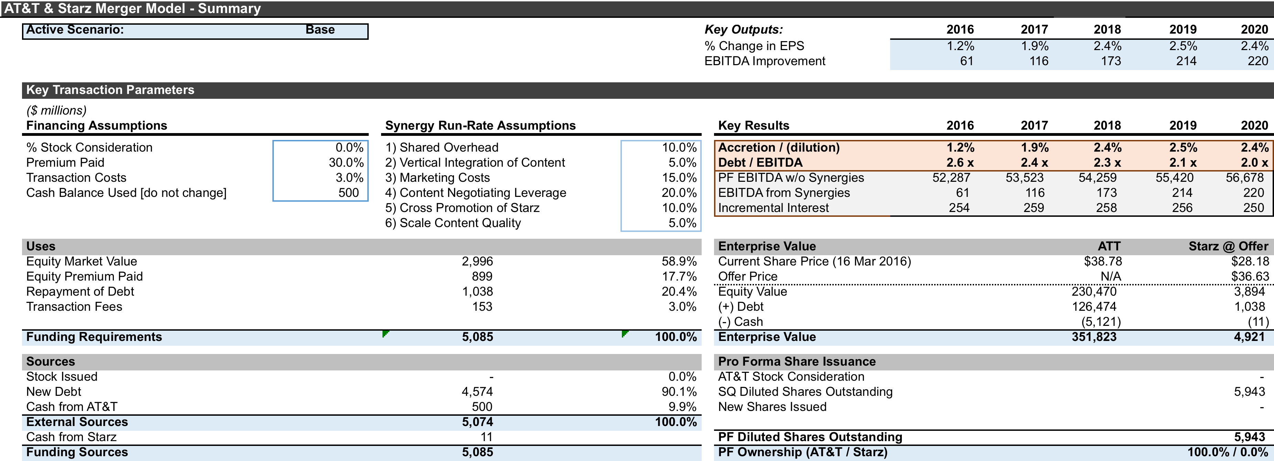

Slide 10
Risk Analysis
Stakeholder | Key Challenge | Potential Mitigation
AT&T Management | Losing Subs to OTT | Leverage Starz Acquisition
Board of Directors | High Required Yield | Cross-Divisional Expertise to up Margins
Shareholders | Limited Capital Gains | Communicate moderate growth plan
Customers | High Churn | Cross-Selling & Bundling
Lionsgate | Bidding War | Firm Offer
Notes:
Trevor
AT&T management has the challenge of losing subs to Over-the-top streaming services but can leverage the Starz acquisition
The Board of Directors require high yields which is where Cross-Divisional Expertise can increase margins
Shareholders receiving limited capital gains can be mitigated by communication of moderate growth plans (Could get questioned on this?)
Customers churn rates are high but can be retained by cross-selling & packaging strategies
Lionsgate Stakeholders could start a bidding war for Starz but AT&T should stick to a firm offer and be willing to look for alternative opportunities if it doesn’t work out
FCC any issues?

Slide 11
Alternative Channel Network Acquisition Opportunities
AMC Networks
  EV: $7.12B, Produce original content (17% international)
  T has fair distribution agreement
MSG Networks
  EV: $2.61B, Suitable for advertising based model
  Sports, Entertainment, Media, Live stream and video demand platform
EV/EBITDA
11.1x | All Media
9.7x | Telecom Buying Media
10.8x | When offering 20%
Notes:
Trevor
Alternative Channel Networks that were considered were AMC networks and MSG Networks which are both along the lines of AT&T’s budget who produce content in the media sector similar to that of Starz.
Furthermore, utilizing a sports, livestream and video demand platform would broaden their diversified platform similar to Starz, having ample synergies
Our EV/EBITDA ratio analysis also determined that there is great value to purchasing media/content

Slide 12
Recommendation
Offer $4.9B for a 100% acquisition of Starz
→ $36.63 per share
Emerging Markets of interest with potential
  → Cuba
Notes:
Trevor
An entry point in the Over-The-Top streaming segment that has been taking revenues away from their cable business.
At the end of the day, we recommend AT&T offering $4.9B to completely acquire Starz given our evaluated per share price of $36.63
We feel there are ample opportunities in other areas as well if the deal doesn’t work out such as moving into emerging markets such as Cuba.

Slide 13
Appendix
Notes:
an entry point in the Over-The-Top streaming segment that has been taking revenues away from their cable business.

Slide 14
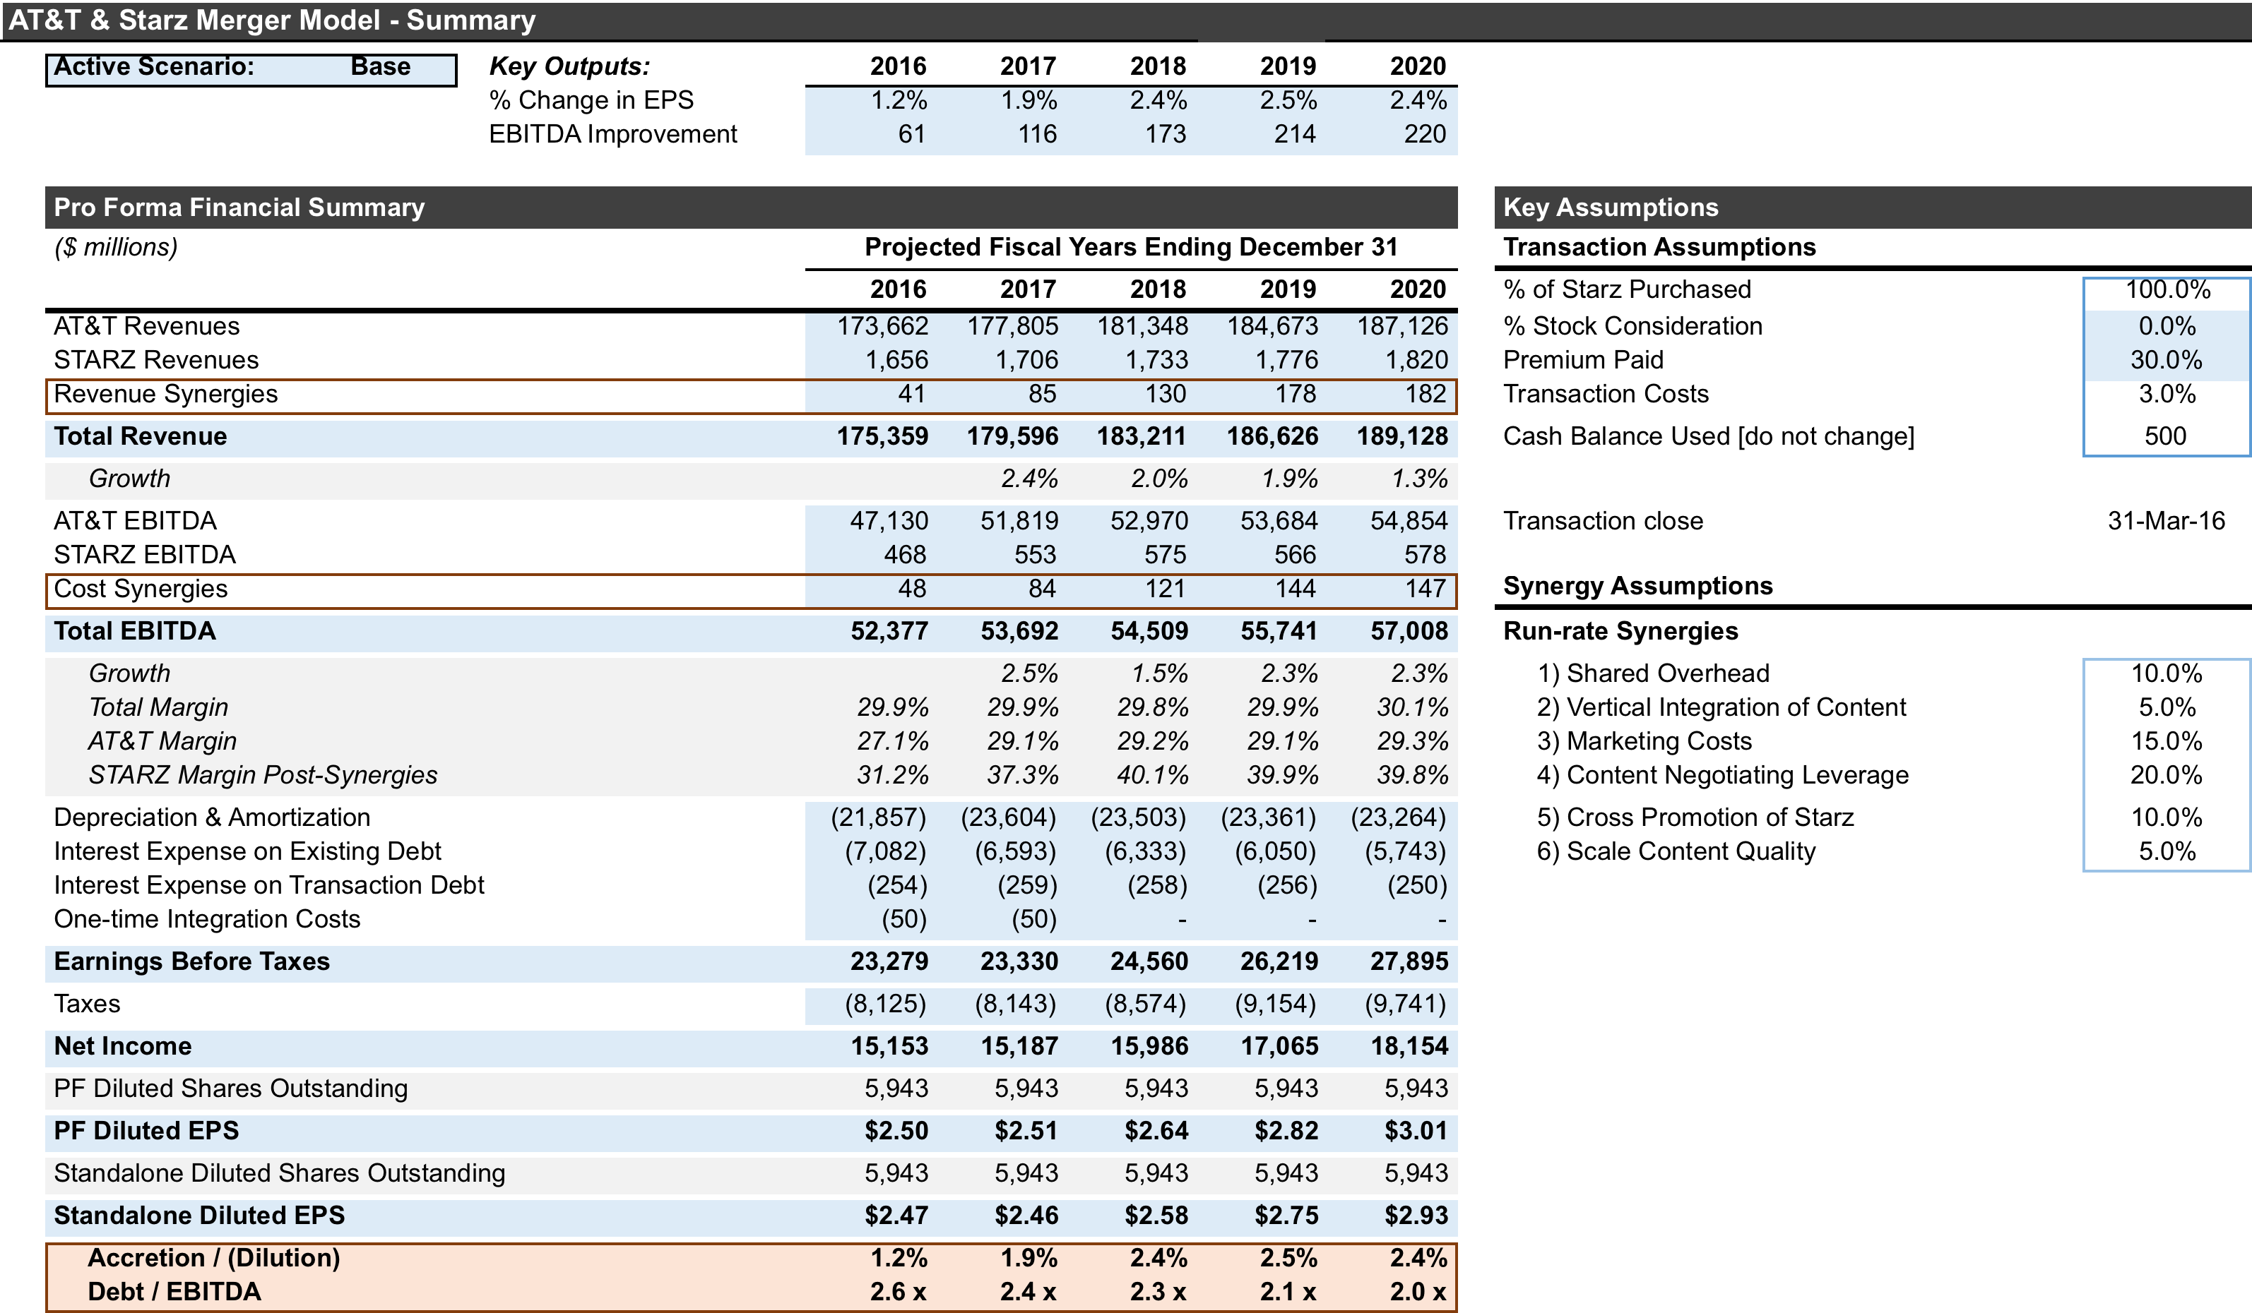

Slide 15
