Slide 1
March, 2016 CFA Research Challenge TEAM D

Slide 2
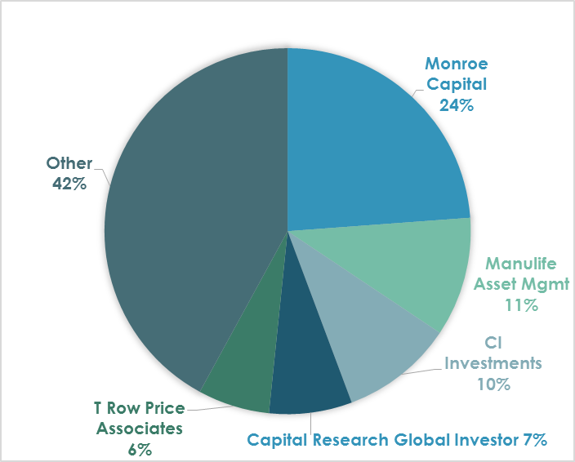
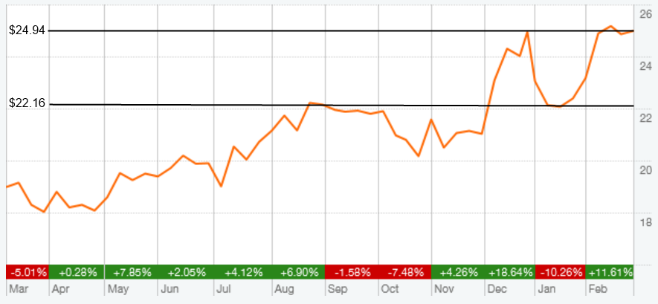
Introduction
% Ownership
Key Highlights:
Stable dividend ($37m)
Changing to a favourable visitor mix
Limited capex spending plans
Restrained Cash Flows
High growth expectations already priced in
Market Profile
Feb 5th, 2016
Closing Price | $23.17
52-Week High/Low | $17.67 - $25.37
Average Volume | 40.78 Mil
Diluted Shares Out | 38.15 Mil
Market Cap | 882.07 Mil
Dividend Yield | 4.35%
Beta | 0.6
EV/Revenue | 4.46
EV/EBITDA | 12.37
Institutional Holdings | 75.54%
Insider Holdings | 0.48%
Risk Analysis
Conclusion
Company Overview
Financial Analysis
Industry & Competitors
Valuation

Slide 3
Recommendation
HOLD
Target Price : $22.16
Consistent Dividend
Committed to $37m per year
Higher RPV Visitor Mix
9% expected increase in Destination guest revenue share
Existing infrastructure in place especially after Olympics
Restrained Cash Flow
Outflow of cash for last 3 years
Available Capacity
Risk Analysis
Conclusion
Company Overview
Financial Analysis
Industry & Competitors
Valuation

Slide 4
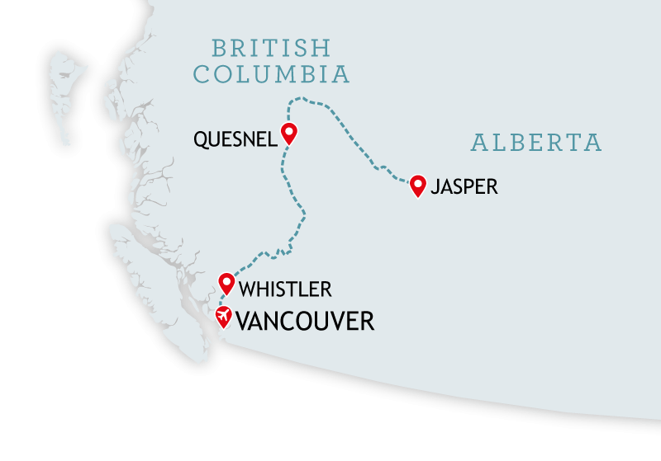
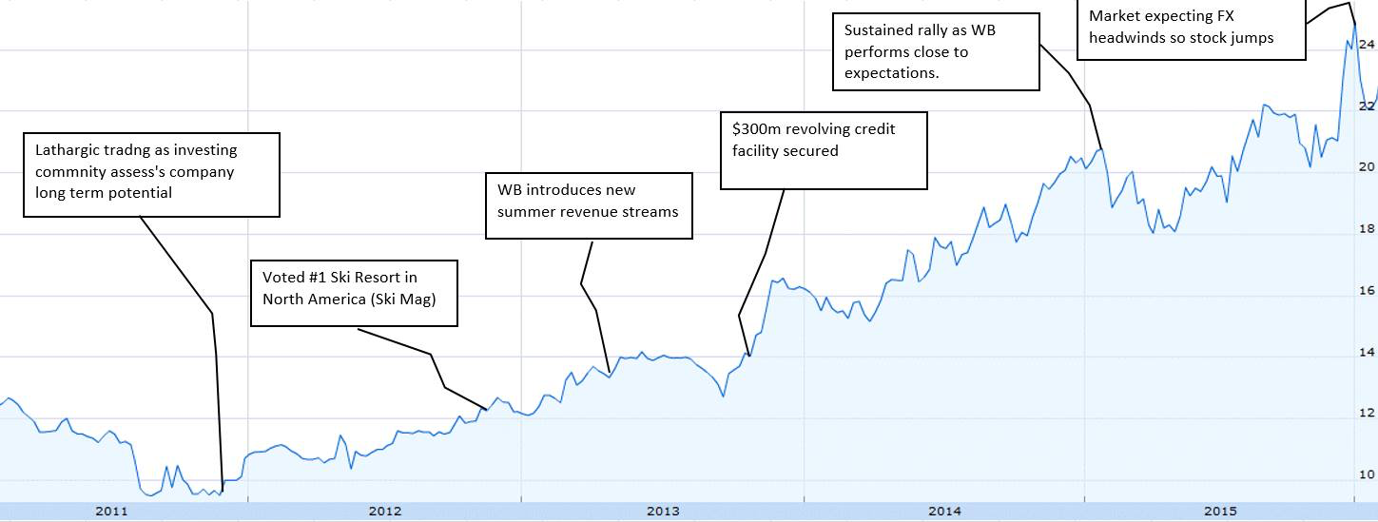
Recent Events
FX tailwinds to cause Stock Price fluctuation
Changes/Improvements to business model impact valuation
Secured Revolving Credit allows financial support
Risk Analysis
Conclusion
Company Overview
Financial Analysis
Industry & Competitors
Valuation

Slide 5
Key Success Factors – Short Term
Economic Factors :
Slowing Domestic Economy
Declining per capita disposable income
Currency Advantages:
Depreciating CAD to spur demand , mitigating the negative impact of declining domestic guests
Whistler’s Stock Price is inversely correlated with CAD-USD rate
Regression Between WB Stock price and CAD $
Risk Analysis
Conclusion
Company Overview
Financial Analysis
Industry & Competitors
Valuation

Slide 6
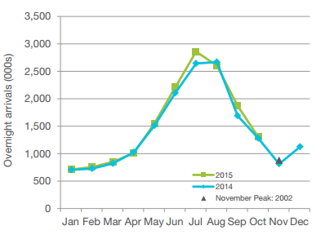
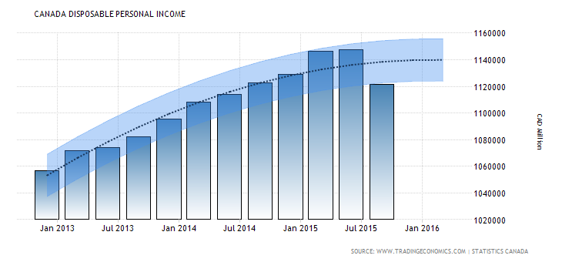
Key Success Factors – Long Term
Canadian Overnight Arrivals
Weather:
Positive correlation of Snowfall with Revenues
Better snow season yield higher local guest numbers
Altering Demographic:
Forecasted increase in disposable income of millennial
Millennia's to outpace other generations in coming years
Canadian Disposable Personal Income
Risk Analysis
Conclusion
Company Overview
Financial Analysis
Industry & Competitors
Valuation

Slide 7
Industry Overview &
Competitive Positioning

Slide 8
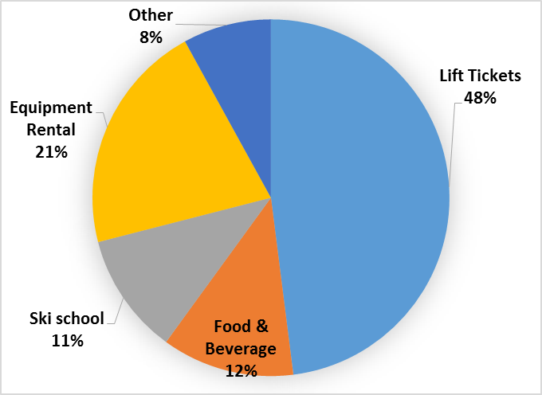
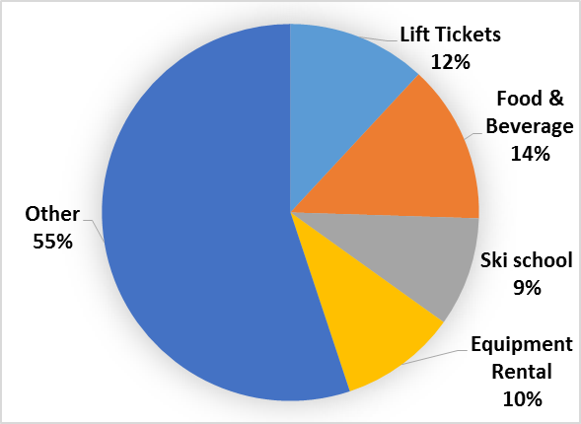
Industry Overview
Whistler Revenue Breakdown
Key Industry Characteristics:
Canadian Industry Revenue of $852.6 Million achieved through CAGR 2% in past 5 years
Next 5 year growth forecasted at 1.2%
Mature Industry – Capital Intensive, Growth lower than GDP growth
Dependent on leisure time and per capita disposable income
Affected by weather conditions as well as international travel drivers
Industry Revenue Breakdown
Risk Analysis
Conclusion
Company Overview
Financial Analysis
Industry & Competitors
Valuation
Notes:
Trevor
Looking at Whistler’s revenue breakdown, equipment rental and retail revenue and ski school is a higher portion of their overall revenue compared to the industry due to destination visitors spending therefore yielding greater margins.
Moving on to the Industry Overview and Competitive Positioning
This industry is relatively mature having a CAGR of 2% in the past five years and is forecasted at 1.2%
-In the top right, some key industry characteristics include revenue streams breaking down into lift tickets, ski school, equipment rental, food and beverage, and other
-Whistler has Equipment rental and retail revenue having a more substantial impact on its overall revenue in comparison to the industry as shown
-In the top middle, the Canadian market is segmented into 65% Destination Visitors and 35% Regional Visitors
2.0% is 2010-2015
1.0 is 2015-2020

Slide 9
Competitive Advantages
Currency Advantages
Available Capacity/Infrastructure
Ideal Snow Conditions
Established Brand
Ideal Demographics
Risk Analysis
Conclusion
Company Overview
Financial Analysis
Industry & Competitors
Valuation
Notes:
Trevor
45 Seconds
(Currency Advantages) – At the top, the Canadian exchange rate has implied an increase in international visitors, therefore adding more annual visitors than Vail and Breckenridge.
(Available capacity/infrastructure) – As shown in the middle, capex has given Whistler the highest lift capacity compared to competitors at almost 70,000 people per hour
(Ideal Snow Conditions) – At the bottom, Whistler’s coastal proximity, high elevation, high precipitation and cooler temperatures are very beneficial for the mountains long-term average snowfall
(Demographics) - Increasing Metro Vancouver population at 8% every 5 years in addition to a more Millennial driven market
Annual Visitors: Travel and Leisure Magazine
http://www.travelandleisure.com/slideshows/americas-most-visited-ski-resorts/2

Slide 10
Financial Analysis

Slide 11
Utilization Rate
Financial
Investment
Operational
Risk Analysis
Conclusion
Company Overview
Financial Analysis
Industry & Competitors
Valuation

Slide 12
Cash Flow Analysis
Assumptions
Debt payment only covers interest payment, and no new loan is borrowed
No issuance of shares
Stable dividend level at $37 Million/annual
Key Points
Dividend goals may be constrained in the short-term by potential cash flow shortages
Worsening liquidity for debt coverage
Risk Analysis
Conclusion
Company Overview
Financial Analysis
Industry & Competitors
Valuation

Slide 13
Valuation

Slide 14
Comparable Valuation
Name | Ticker | Mkt Cap (USD) Millions | Price (I) | Net Debt | EV / EBITDA | Dividend Yield(%) | P/E Ratio
Whistler Blackcomb Holdings | WB CN | 643.00 | 16.92 | 169.24 | 12.37 | 4.2% | 40.24
Vail Resorts Inc | MTN US | 4343.38 | 119.85 | 790.77 | 14.01 | 1.9% | 40.26
Extended Stay America Inc | STAY US | 2659.72 | 13.00 | 2709.92 | 9.84 | 3.9% | 27.34
Marriott Vacations World | VAC US | 1516.60 | 48.82 | 486.96 | 8.86 | 1.5% | 16.35
Hyatt Hotels Corp | H US | 5619.68 | 40.48 | 743.00 | 9.09 | 0.0% | 55.63
Starwood Hotels & Resorts | HOT US | 10482.73 | 62.03 | 1295.00 | 9.78 | 3.4% | 24.33
Hilton Worldwide Holdings | HLT US | 17863.00 | 18.09 | 10188.00 | 10.38 | 0.8% | 15.20
Royal Caribbean Cruises LTD | RCL US | 16187.26 | 73.58 | 8545.49 | 11.73 | 1.8% | 25.06
Carnival Corp | CCL US | 35754.18 | 45.51 | 7392.00 | 10.23 | 2.4% | 21.26
Average |  | 10563.28 | 48.70 | 3591.15 | 10.70 | 2.2% | 29.52
Peer Group Selection Criteria
Primary revenue stream in Travel /Hospitality
Industry leaders(Brand, Market Share, or Market Cap)
Relatively comparable EV/EBITDA multiples
Exposed to similar systematic risks
Risk Analysis
Conclusion
Company Overview
Financial Analysis
Industry & Competitors
Valuation

Slide 15
DCF Assumptions - Revenue
Revenue and EPS
 |  |  |  |  | Projection Period
 |  |  |  |  | Year 1 | Year 2 | Year 3 | Year 4 | Year 5
 | 2012 | 2013 | 2014 | 2015 | 2016 | 2017 | 2018 | 2019 | 2020
12 Months Ending | 09/30/2012 | 09/30/2013 | 09/30/2014 | 09/30/2015 | 09/30/2016 | 09/30/2017 | 09/30/2018 | 09/30/2019 | 09/30/2020
Revenue | 236.4 | 240.8 | 254.5 | 262.3 | 285.0 | 295.3 | 303.4 | 310.5 | 316.9
YOY Growth(%) | 9.4% | 1.9% | 5.7% | 3.0% | 8.7% | 3.6% | 2.7% | 2.3% | 2.1%
EPS | $ 0.41 | $ 0.37 | $ 0.47 | $ 0.54 | $ 0.75 | $ 0.81 | $ 0.86 | $ 0.91 | $ 0.95
YOY Growth(%) | 2% | -10% | 27% | 15% | 39% | 8% | 6% | 5% | 4%
Risk Analysis
Conclusion
Company Overview
Financial Analysis
Industry & Competitors
Valuation

Slide 16
Maintenance CAPEX
Stable Operating Expenses
Consistent Long-term Debt
Assumed Tax Stability
DCF Assumptions - Valuation
Assumptions
10-Year Canadian Bond ¹ | 3.00%
Market Risk Premium | 6.50%
Expected Market Return | 9.50%
Beta ² | 0.8
Cost of Equity | 8.20%
Cost of Debt ³ | 3.98%
Tax Rate | 27.20%
After-Tax Cost of Debt | 2.90%
Current Market Cap | 878.30
Debt-Equity Ratio | 0.26
WACC | 7.09%
Perpetual Growth Rate | 2.00%
Annual depreciation account for 7.5% of net PPE
Operating expenses forecasted at 63% of revenue
No debt repayment is assumed, only payment of interest
The 6.2% of tax on top of Effective Tax Rate to account for Nippon Cable’s minority interest tax expenses
Expected 10-Year Canadian Treasury
Forward Looking Beta: Average of industry beta and WB’s beta
WB’s 2015 Q3 Effective Interest Rate
Risk Analysis
Conclusion
Company Overview
Financial Analysis
Industry & Competitors
Valuation

Slide 17
Target Price
50% DCF
Price: $21.57
50% EV/EBITDA
Price: $22.74
Target Price: $22.16
Risk Analysis
Conclusion
Company Overview
Financial Analysis
Industry & Competitors
Valuation

Slide 18
Risk Analysis

Slide 19
Main Risks
Financial
Operational
External
Debt & Interest Coverage
High
Public Relations
Seasonal Revenue Streams
Climate Risk
Probability
Seasonal Workforce
Government Regulation
Low
Insignificant
Severe
Impact
Risk Analysis
Conclusion
Company Overview
Financial Analysis
Industry & Competitors
Valuation

Slide 20
Conclusion

Slide 21
Conclusion
Limited Future Capex
Industry growth at 1.2%
Low quality revenue growth
High price premium
HOLD
12 M Target Price
$22.16
Risk Analysis
Conclusion
Company Overview
Financial Analysis
Industry & Competitors
Valuation

Slide 22
Despite the market’s optimism, we expect the aggressive short term revenue growths to be unsustainable moving forward into the long term

Slide 23
Appendix

Slide 24
Conclusion
Appendix 1 – Competitor Analysis
Canada
Intrawest (Mount Tremblant, Blue Mountain)
Northshore Mountains (Seymour, Grouse, Cypress)
Interior Mountains (Revelstoke, Big White, Silverstar)
United States
Vail (Breckenridge, Keystone,Northstar, Vail Mtn.)
Intrawest (Snowshoe, Stratton, Winter Park)
Boyne Resorts (Big Sky, Brighton, Boyne Mtn.)
POWDR Corporation (Park City, Copper Mtn.)

Slide 25
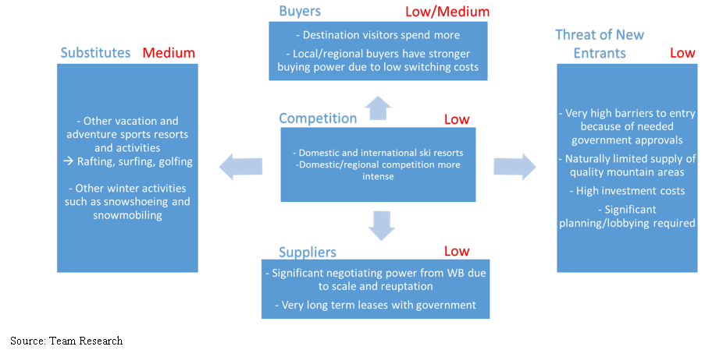
Conclusion
Appendix 2 – Porters 5 Forces

Slide 26
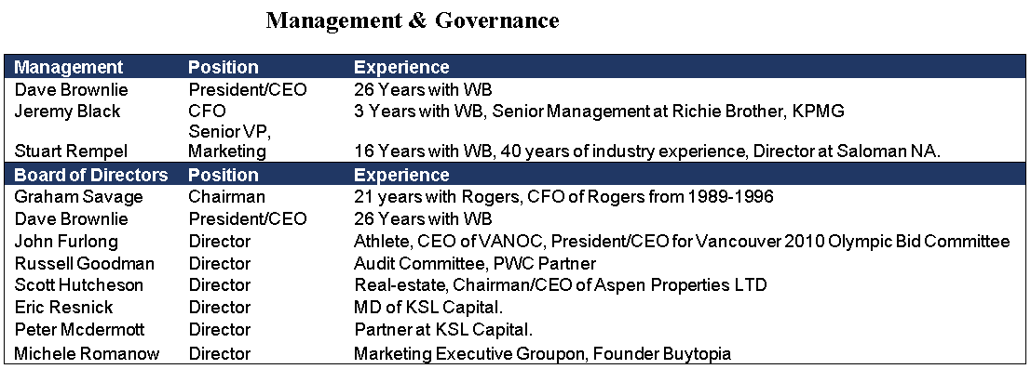
Conclusion
Appendix 3 – Mgmt and Corporate Governance
Recent C-Suite trading - CEO purchase 31,167 shares on Dec. 21st
Versatile experience in C-Suite

Slide 27
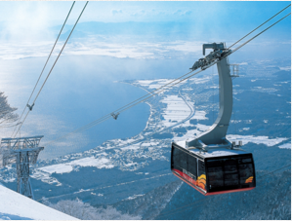
Conclusion
Appendix 4 – Nippon Cable
What is Nippon Cable?
A comprehensive Japanese supplier of cable and transportation facilities
System engineering capabilities
Control stake in Japanese and CDN resorts and G.C.’s
→Owns 25% of Whistler Blackcomb
→Owns 100% of Sun Peaks Resort

Slide 28
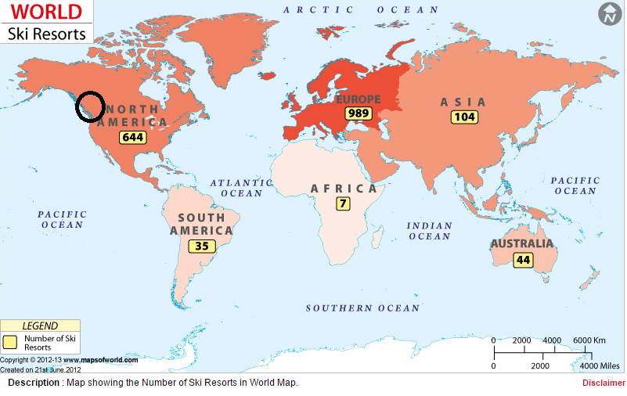
Conclusion
Appendix 5 – Worldwide Ski Resorts

Slide 29
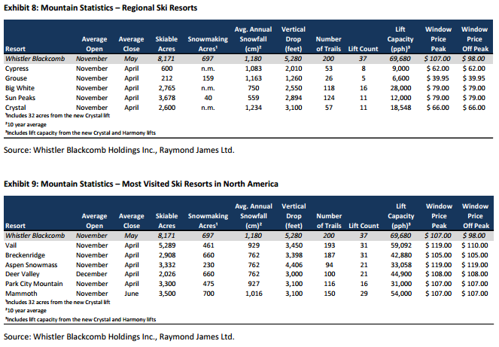
Conclusion
Appendix 6 – NA Mountain Stats

Slide 30
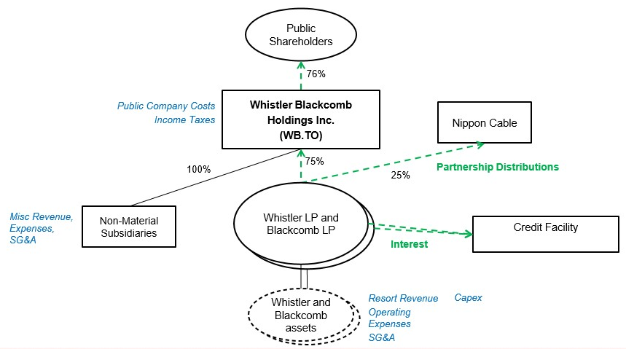
Conclusion
Appendix 7 – Company Structure

Slide 31
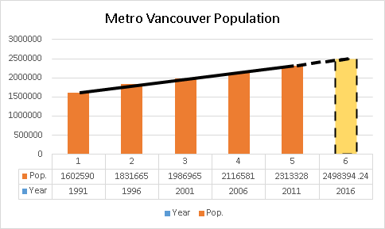
Conclusion
Appendix 8 – Population Estimate

Slide 32
Appendix 9 - DCF
Valuation
 |  |  |  | Projection Period
 |  |  |  | Year 1 | Year 2 | Year 3 | Year 4 | Year 5
In Millions of CAD except Per Share |  |  |  | 2016 | 2017 | 2018 | 2019 | 2020
12 Months Ending |  |  |  | 09/30/2016 | 09/30/2017 | 09/30/2018 | 09/30/2019 | 09/30/2020
Revenue |  |  |  | 285.0 | 295.3 | 303.4 | 310.5 | 316.9
YOY Growth(%) |  |  |  | 8.7% | 3.6% | 2.7% | 2.3% | 2.1%
EBIT |  |  |  | 68.6 | 73.0 | 76.5 | 79.7 | 82.6
YOY Growth(%) |  |  |  | 30.6% | 6.4% | 4.8% | 4.1% | 3.6%
EBITDA |  |  |  | 102.6 | 106.3 | 109.2 | 111.8 | 114.1
YOY Growth(%) |  |  |  |  | 3.6% | 2.7% | 2.3% | 2.1%
Free Cash Flow to Firm |  |  |  | 52.24 | 54.17 | 56.53 | 58.72 | 60.74
Years to Discount |  |  |  | 1 | 2 | 3 | 4 | 5
Cost of Capital |  |  |  | 7.09% | 7.09% | 7.09% | 7.09% | 7.09%
Discount Factor |  |  |  | 1.071 | 1.071 | 1.071 | 1.071 | 1.071
PV of Free Cash Flow to Firm |  |  |  | 48.78 | 47.24 | 46.03 | 44.65 | 43.13
Risk Analysis
Conclusion
Company Overview
Financial Analysis
Industry & Competitors
Valuation

Slide 33
Appendix 10 Financials Analysis
Ratios | 2012 | 2013 | 2014 | 2015 | 2016 | 2017 | 2018 | 2019 | 2020
Profitability
EBITDA Margin | 36.0% | 35.9% | 36.4% | 35.4% | 36.0% | 36.0% | 36.0% | 36.0% | 36.0%
Operating Profit Margin | 19.6% | 19.2% | 20.2% | 19.4% | 24.1% | 24.7% | 25.2% | 25.7% | 26.1%
Net Income Margin | 6.6% | 5.9% | 7.0% | 7.8% | 10.0% | 10.5% | 10.8% | 11.1% | 11.4%
Return on Assets | 1.8% | 1.7% | 2.2% | 2.6% | 3.6% | 3.9% | 4.2% | 4.4% | 4.6%
Return on Equity | 3.3% | 3.2% | 4.2% | 5.1% | 7.3% | 8.0% | 8.6% | 9.1% | 9.5%
Liquidity
Current Ratio | 134.9% | 122.8% | 61.6% | 62.7% | 68.5% | 75.2% | 83.4% | 92.9% | 103.6%
Quick Ratio | 98.5% | 86.3% | 22.3% | 16.2% | 22.0% | 28.6% | 36.8% | 46.3% | 57.0%
Cash Ratio | 91.2% | 79.9% | 14.5% | 9.7% | 15.5% | 22.2% | 30.3% | 39.8% | 50.5%
Activity
Total Inventory Turnover | 17.1 | 15.2 | 13.7 | 11.6 | 11.6 | 11.6 | 11.6 | 11.6 | 11.6
Total Asset Turnover | 0.3 | 0.3 | 0.3 | 0.3 | 0.4 | 0.4 | 0.4 | 0.4 | 0.4
Financial Leverage
Long-term Debt to Assets | 29.7% | 30.5% | 28.6% | 29.3% | 29.4% | 29.5% | 29.6% | 29.7% | 29.7%
Long-term Debt to Equity | 54.4% | 58.2% | 54.6% | 58.0% | 59.3% | 60.2% | 60.9% | 61.3% | 61.4%
Earning per Share | $ 0.41 | $ 0.37 | $ 0.47 | $ 0.54 | $ 0.75 | $ 0.81 | $ 0.86 | $ 0.91 | $ 0.95
Dividend Payout Ratio | 237.8% | 263.2% | 207.5% | 180.6% | 129.5% | 119.8% | 112.9% | 107.3% | 102.8%

Slide 34
Appendix 11 – Income Statement

Slide 35
Appendix 12 - Balance Sheet

Slide 36
Appendix 13 Financials - Cash Flow

Slide 37
Appendix 14 Financials - Others

Slide 38
